Slide 1
DT228/DT282/2 Databases I
Introduction to Databases

Slide 2
Learning Objectives
By the end of this lesson you will:
Understand what databases are
Understand what databases are used for
Understand how databases are structured
Become familiar with some of the technical vocabulary used for databases
Be able to start building a design for a database

Slide 3

Data
SAP estimate that an organisation with 1000 employees stores on average 200 Terabytes of data

Slide 4
Data
There is a huge volume of Data in the world
You can find it in:
Social media apps
Web
Web apps
Filing cabinets
Bills, orders, complaints..
Equipment
Lists
Peoples’ memories

Slide 5

Data
Personal Data
Transactional Data
Web data
Sensor data
This only becomes useful if it is stored in a way that allows it to be used for information purposes
By Machines and by Humans
Machine Readable Data v Human Readable Data

Slide 6

Data
Data is valuable
But unless it is refined it cannot really be used

Slide 7
General Concepts
Data
Known facts
Types: numbers, text, graphics, images, sound, videos
Information
Data that has been given meaning by way of relational connection.
"meaning" can be useful, but does not have to be

Slide 8
What is a database?
A database is a structured collection of data organised to model some aspect of reality and support information processes.
A database management system (DBMS) allows us to manage the content/information stored in a database

Slide 9
What does “managing information” mean?
Organising information
Keep track of data
Finding the bits you need and processing them in the way you arrange for them to be processed
Provide foundation for predicting need…
Making information work (for human users and applications)
Making information useful (for human users and applications)
Making information easily accessible and integrated with a range of higher order activities

Slide 10
Managing as re-processing
The processing power of a database allows it to:
Sort, Match, Link
Calculate, Aggregate
Skip, Arrange …..
Can be used to provide human readable data
Mailing lists
Reports/Summaries
Visualisations….
And be used as part of higher order tasks/to achieve higher order goals

Slide 11
Relational Database
Definition
A database is a shared persistent collection of logically related data supporting several different applications within an organisation.
Shared – used simultaneously by many applications and useres
Persistent i.e. permanently stored
Data stored is all related in some way
Database supports/manages data for several different applications
Database (DB)

Slide 12
Applications
“Traditional” DB Applications
Databases form foundation of IT systems in areas such as public administration (CAO), payroll, banking (account info.), retail (inventory)etc.
Most web sites/apps are built around data backend
More emergent database reliant applications
Amazon, YouTube, Facebook, Wikipedia

Slide 13
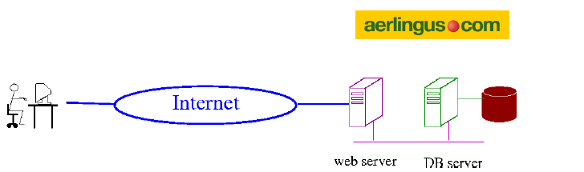
Typical E-Commerce site
User uses browser to interact with Web-server
Web-server holds programs to await and respond to customer enquiries
Database holds the data (e.g. flight schedules, prices, availability)
When user submits some sort of information
Relevant program on the web server is “awakened"
It extracts details of customers request queries database (e.g. for suitable flights)
It generates a response (web page) for return to customer
When transaction is confirmed, all relevant details are stored in the database via the relevant program

Slide 14
Typical E-Commerce site
Database is protected
Not directly accessible
Only your programs can talk directly to it

Slide 15
DBMS
A Database Management System (DBMS) is the set of software which manages a DB or set of DBs
Aims of DBMS:
Efficient, reliable and secure management of large amount of persistent data.
Provide Data Manipulation Language (DML) (language for storing, retrieving and updating data in the DB).
Provide Data Definition Languages (DDL) (language for defining the data).
Examples:
Proprietary: MS Access, MS SQL Server, MySQL Enterprise, Oracle
Open source: MySQL Cluster, PostgreSQL

Slide 16

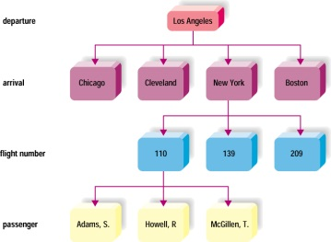

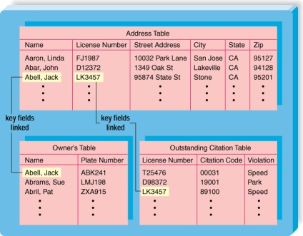

DBMS Structure
Hierarchical database
Network database
Relational database
Multidimensional database
Object-oriented database
Notes:
Purpose of database is to integrate individual items of data into useful information; can be done sequentially, directly, or index-sequentially
Databases can be organized differently to best fit their use: Hierarchical; Network; Relational; Object-oriented; Multidimensional

Slide 17
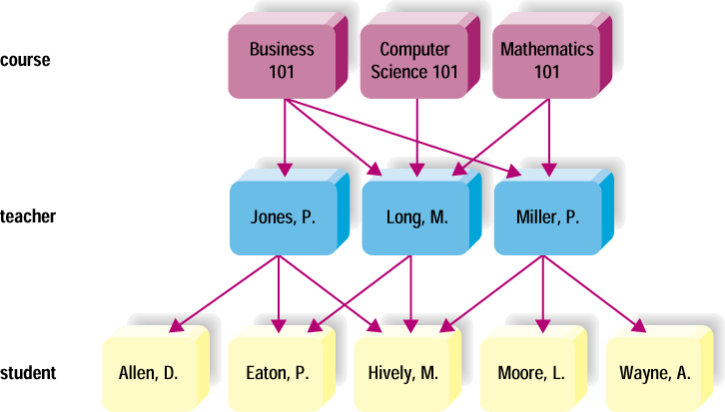
Relational Database
Data stored in table or relation
Tables related via a common data item
No predetermined access path
Use of keys and linkage through keys for navigation
Easy to use – Simple to add to, delete and modify
Most flexible

Slide 18

Relational Database
Dominant database concept since 1980s
Edgar “Ted” Codd (1923-2003),
English computer scientist
Introduced relational database concept c1970
Turing Award 1981

Slide 19
Database V.S. File
In the database approach, a single repository of data is maintained that is defined once then accessed by various users
The major differences between DB and File are:
Ability of DB to self-describe
Insulation between programs and data
Support of multiple views of the data
Sharing of data and multiuser transaction processing

Slide 20
Relational Database
Database
A database consists of a set of named relations (aka tables)
Relation ( Two dimensional table)
A set of tuples (aka rows) with identical column structure
Each column named with an attribute (must be distinct)
Values in each column of uniform “type” drawn from some set (domain) such as integer, text, date and so on.

Slide 21
Relational Database
Data is organized into tables
Rows & Columns – Records & Fields – Tuples & Attributes
Each table usually represents a ‘thing’ we are interested in storing data about
Each row represents a single occurrence of this ‘thing’
Each column represents a piece of data we want to store about this ‘thing’
A subset of columns can act as a key

Slide 22


Definition of a Relational Database
A relational database is a collection of relations or two-dimensional tables.
When designing a database to store information about employees, you create several tables to store different pieces of information about your employee.
Oracle
server
Table name: EMPLOYEES
Table name: DEPARTMENTS
…
…
Notes:
Definition of a Relational Database
A relational database uses relations or two-dimensional tables to store information.
For example, you might want to store information about all the employees in your company. In a relational database, you create several tables to store different pieces of information about your employees, such as an employee table, a department table, and a salary table.

Slide 23

Example
Suppose we want to store data about a student on DT228 or DT282 in order than they can successfully register, be given results, a timetable, know who is teaching what? What pieces of data would we need?

Slide 24
Example
How would we organise it?

Slide 25
Relational Database
We can also store information about how ‘things’ are related to each other
Relationships

Slide 26
Example
What relationships do we have between our data for DT228/DT282?

Slide 27
Relational Database
According to relational model, all rows should be distinct;
Values must be atomic (“elementary" and “unstructured")
Examples: integers, decimals, text, booleans, dates
Can't have lists, sets, records, arrays as single values
(Can represent lists etc. by other means)
Every relation has a key:
Some subset of attributes such that no two tuples in the relation can ever have the same key value.
Data can be protected via constraints to ensure only data that conforms to requirements can be stored

Slide 28
Relational Database
Database system contains not only the database itself but also a complete definition of the database structure and constraints
The information stored in the catalog is called Meta-data (data about data)
it describes the structure of the primary database.
Metadata = ‘data about data’
At most basic level describes each table column e.g. what type of data can be held in it? Numbers, characters, sound….

Slide 29
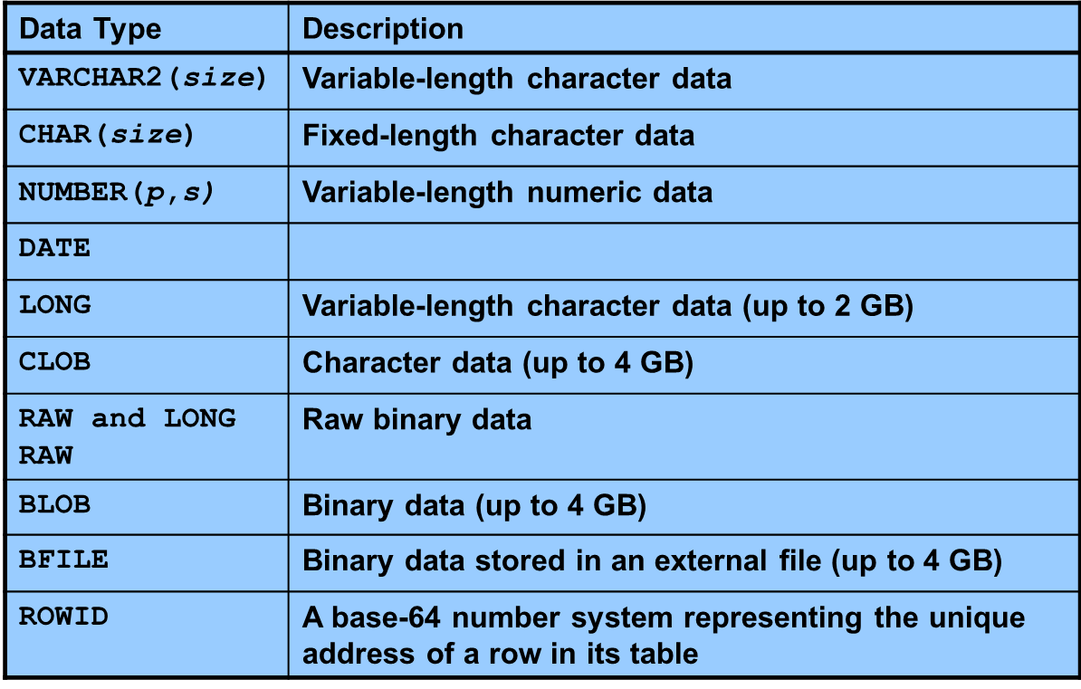
Datatypes Oracle

Slide 30
Exercise: Breaking down content into fields
What meta-data do we need for the data we identified for DT228?

Slide 31
Relational Database Schema V Instance
Database Schema
the “structure” of the database in terms of constituent tables and the organization of each table in terms of attributes and domains
and the “interpretation” of these in terms of the real-world situation the DB models; remains fixed over time
Database Instance
any specific collection of values populating the DB that conforms to the schema; changes as DB is modified

Slide 32
Database Application
User
Application Programs
DBMS
Data about the Data
Metadata
Data

Slide 33
Programming Language
Data is accessible using Standard Query Language (SQL)
ANSI (American National Standards Institute) standard computer language for accessing and manipulating database systems.
All DBMS adhere to the standard but some implement their own ‘dialect’
SQL statements are used to create, retrieve and update data and data structures in a relational database.
Includes:
Data Manipulation Language (DML)
Data Definition Language (DDL)
Pronounced either as “ess-qu-ell” or “sequel"

Slide 34
Data Manipulation Language
Syntax for executing queries, updating, inserting, and deleting records.
SELECT - extracts data from one or more table
INSERT INTO - inserts new data into a table
UPDATE - updates data in a table
DELETE FROM - deletes data from a table

Slide 35
Data Definition Language
Syntax for creating,editing, deleting:
Databases
Tables
Views
Indexes
Constraints
Users
Privileges
CREATE DATABASE SampleDB;
CREATE TABLE Example (
Name varchar(100)
Size int(10)
Gc decimal(5)
Accession varchar(10)
Release date(8)
Center varchar(100));
ALTER TABLE Example ADD Sequence varchar;
DROP TABLE Example;

Slide 36
Queries
Queries are the information retrieval requests you make to the database
Your queries are all about the information you are trying to gather (from that stored in the database)
The complexity of your query will depend on the complexity of the fields that the data is housed in, the functionality of the database, and the type of information you are trying to gather.
Queries = Question
Notes:
Queries are the information retrieval requests you make to the database - the way you search through the information. The complexity of your query will depend on the complexity of the fields that the data is housed in, the functionality of the database, and the type of information you are trying to gather.
The queries placed by people using your database can be a guide to, and a reflection of how the data is being used. As the limits of the queries they can run will in large measure be determined by the fields in the database you can see how important it is to consider your data-users’ needs, when designing the database. You need to think about the work of your data users – whether they are researchers, administrators, fundraisers, or lobbyists. The work they do with the information will affect the way they need to process it and the form in which they need to receive it.
Ask yourself:
What sorts of data comparisons will they want to make? Historical, regional, institutional?
What methods of sorting/ordering will they need?
How will they want results presented?
What search choices will they need?
Answering these questions involves understanding how they work with information. The answers to these questions must inform your database planning work.

Slide 37
Example
DDL – Create the Table
DML – Find names of 500 point students
CREATE TABLE students
(
idnumber VARCHAR(9),
firstname VARCHAR(20),
lastname VARCHAR(20),
dateofbirth DATE,
address VARCHAR(200),
email VARCHAR(50),
course VARCHAR(5),
points number(3),
PRIMARY KEY (idnumber)
);
SELECT firstname, lastname
FROM students
WHERE points >= 500;

Slide 38
Query
SELECT firstname, lastname
FROM students
WHERE points >= 500;
Meaning “Extract names (first and last) of all students with at least 500 points"
SELECT, FROM, WHERE are keywords
Other words are names of table/columns
>= means greater or equal to
Terminate query with semicolon

Slide 39
Reports
If the query is a question...
...then the report is its answer
In the form of a table
(temporary only for the duration of the query)
Includes specified columns and rows only
Original table left completely untouched
Reports can be tailored to the needs of the data-user, making the information they extract much more useful
For example:
An alphabetical list of students enrolled on a module
A sheet of mailing labels for students sorted by county

Slide 40
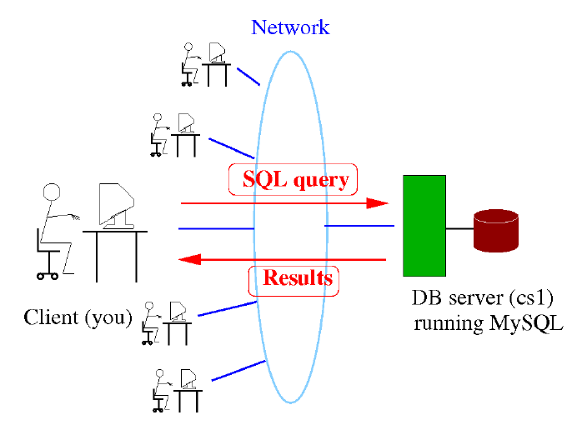
SQL
Database server: machine that runs DBMS (e.g. Oracle)provides database “service” to clients
Clients may interact directly with DBMS
1 Client connects to DBMS (logs in)
2 Client types SQL query and submits
3 DBMS executes query and returns results to client
4 Repeat (2,3) at will; disconnect when done
DB SERVER

Slide 41
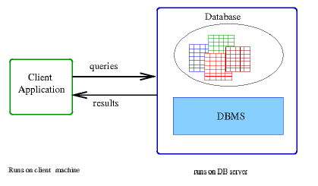
SQL
Database application: program that “talks” to DB (via DBMS)
Example: student transcript generator
Program generates SQL queries, sends to DBMS
DBMS services query, returns results to program
Program manipulates results as needed

Slide 42
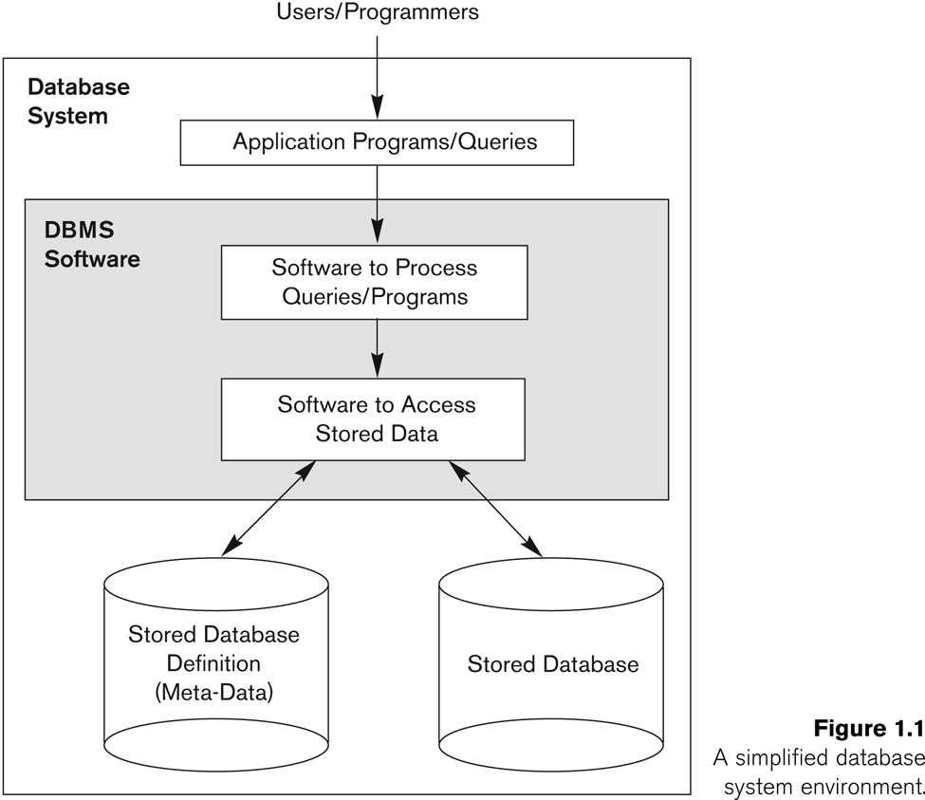
Database System Environment

Slide 43


Oracle
98% of Fortune 500 companies use it (including Google)
You can search for companies at https://www.oracle.com/search/customers?Nr=112
40% of the paid data market

Slide 44

When I hate Oracle who do I call?
Larry Ellison
Co-founder of Oracle Corporation and was CEO from its founding until September 2014
Net worth 60.1 billion USD (2017) (Forbes magazine)
#4 on the Richest in Tech List (Forbes)

Slide 45

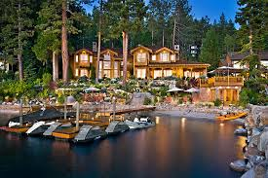

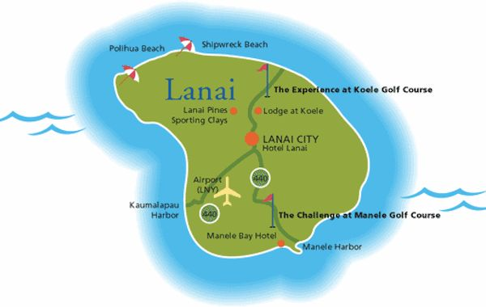

He may not care ….he has a BILLION dollar credit limit

Slide 46
Database Design
Before we can implement a database (and subsequently manipulate the data in it) we must design the database
This starts at the conceptual level
Figuring out what information purposes the database is to serve
What questions do the users need to be able to ask of the database?
What pieces of data make up this information? What type of data is it?
What things these pieces of data describe?
How the things we want to store data about can be linked together to provide the information needed?

Slide 47

Data Models (The Cornerstone of Design)
Model of system in client’s mind
Entity model of client’s model
(Logical Model)
Table model of entity model
(Physical Model)
Oracle
server
Tables on disk
Notes:
Data Models
Models are a cornerstone of design. Engineers build a model of a car to work out any details before putting it into production. In the same manner, system designers develop models to explore ideas and improve the understanding of database design.

Slide 48
Database Modeling and Implementation Process
Analysis
Entity Relationship Design
(Logical)
Relational Model
(Logical/ Physical)
Relational DBMS
(Physical)

Slide 49
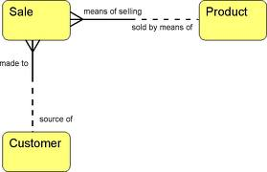
Entity Relationship Model
A detailed, logical representation of the data for an organisation, business area or process

Slide 50
The Entity-Relationship Model
Expressed in terms of:
Entities involved (things about which data is to be stored)
Relationships (or associations) among those entities and
Attributes (properties) of both the entities and their relationships

Slide 51
Entity
Entity
THING or OBJECT of interest to the organization being modeling
E.g. person, place, object, event, concept
Something about which the organisation needs to store data to fulfill some function
Possible Entities
Obvious physical things,
Persons, places, objects e.g. Customer, Student, Course, products
Transactions or events
Orders, Sales, Hospital Admissions, reservation
Concepts
Plan, Schedule, Account, Course, Fund

Slide 52
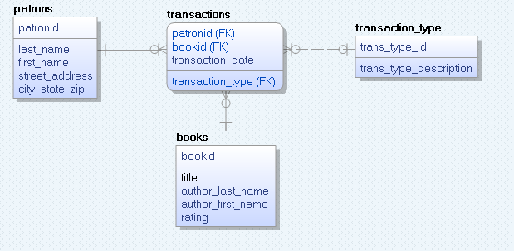
ERD – Simple Library
Primary Key: all items above the line
Foreign Key: (FK) after relevant column

Slide 53
Instance
An instance of an entity is a single occurrence of an entity
It describes, for example, one particular customer or product
E.g. The student John Browne is an instance of the Student entity
An entity type is described just once (using metadata) in a database (using your Create Table)
Many instances of that entity type may be represented by data stored in the database
e.g. – there is one EMPLOYEE entity type in most organisations, but there may be hundreds of instances of this entity stored in the database
Notes:
Entity is a template or blueprint – defines structure
Instance is a filled in version of template
E.g. students within college

Slide 54
Entity and Entity Instances
Entity is a blueprint all instances are based on
Betty Arnold
John Taylor
Lisa Simmons
Bill Macy
Student

Slide 55
Entities and Entity Instances
entity
Student ID | Last Name | First Name
2144 | Arnold | Betty
3122 | Taylor | John
3843 | Simmons | Lisa
9844 | Macy | Bill
2837 | Leath | Heather
2293 | Wrench | Tim
instance
Each Instance must have a unique identifier – called the primary key

Slide 56
How do you create a model? Step 1
Discover the entities about which you need to store data
Conduct Interviews and Document analysis
Ask what things they would like to capture, store, produce information about
Study forms, files, reports
Identify key words
Some identify event entities e.g. orders, payments etc
Look for relationships between things
Give entities meaningful names
Name with NOUNS
May include adjectives e.g. customer order, stock order
Define them in business terms
Capitalise the names
Notes:
Know enough now to read a data model and interpret them
Key words – pay attention to key words in discussion e.g. clients., members, stock

Slide 57
Exercise
A local county council organises football competitions for school children.
Competitions are held on different dates for different age groups with fees and prizes. Each competition has an ID.
There are lots of teams who compete. Each team has an ID, a name and an age group.
What are the entities?

Slide 58
Attributes
An entity is represented by a set of attributes,
Descriptive properties possessed by all members of an entity set.
Attribute of an entity
pieces of data we want to store about an entity
a descriptive property or characteristic of an entity
student = (student-id, student-name, student-address, student-email)
Only want to record attributes that are of significance to the organisation
The value of an attribute is the value of that attribute for a particular entity occurrence (or instance)
“John Browne” is the value of StudentName attribute
Notes:
Entity is a thing we want to store data about – we need to identify the specific pieces of data we want to store about each instance

Slide 59
Entities and Entity Instances
attributes
Student ID | Last Name | First Name
2144 | Arnold | Betty
3122 | Taylor | John
3843 | Simmons | Lisa
9844 | Macy | Bill
2837 | Leath | Heather
2293 | Wrench | Tim
Attribute values

Slide 60
How do you create a model? – Step 2
For each entity
Identify its attributes
Decide on a name (starting with lowercase)
Identify the correct data type and size required for each

Slide 61
Exercise
Each competition has a unique numeric ID, a name (up to 50 characters), an entrance fee (up to 100euro), the prize (up to 1000.00euro) and the date on which the competition will happen. None of these allow null values.
Each team has a unique numeric ID, a name (up to 50 characters), an age group (2 digits).
What are the attributes?

Slide 62
Identifying Instances of Entities
Instances are identified through keys
An entity can have more than one key
The primary key to an entity is an attribute or set of attributes that uniquely identify each occurrence of the entity
Must be unique for each occurrence of an entity
Must always have a value
e.g. students are always assigned a number as soon as they register
Should not contain an attribute whose value is likely to change
e.g. using name or telephone number

Slide 63
Primary Keys
A candidate key is a key that could potentially become a primary key
Any candidate key that is not selected to be a primary key is termed an alternate key
A key consisting of a group of attributes is called a compound or concatenated key

Slide 64
How do you create a model? – Step 3
For each entity
Identify which attribute will uniquely identify it
PRIMARY KEY
Picking Keys
Value of key should not change over lifetime of entity
Value of key cannot be null
Value must be valid
Possibilities
Codes used in business
Serial codes, alphabetic codes
Invent a key
Combine a number of attributes
Invent a new attribute for the key

Slide 65
How do you create a model? Step 4
Identify relevant constraints on the attributes
E.g. NOT NULL, UNIQUE,

Slide 66
How do you create a model? Step 5
Identify relationships between entities
A relationship is a link or an association between two entities which is meaningful for the organisation
e.g. A Customer ‘places’ an Order
A relationship is a natural business association that exists between one or more entities
May represent an event
May represent logical affinity
Relationships usually arise because of
association - a Customer ‘places’ an Order
structure - an Order ‘consists’ of Order-Lines
All relationships that are usable only involve two entities
Name relationships with VERBS.

Slide 67
Relationships
We relate entities to each other in quantitative terms
i.e. in terms of the quantity of instances of one entity that is related to a quantity of instances of the second.
All relationships are bi-directional so cardinality must be defined in both directions for every relationship
Cardinality defines the minimum and maximum number of instances in one entity that may be related instance(s) of the other entity
Also called complexity or degree of the relationship
Examples
A customer places one or more orders
An order is placed by one or more customers
An order consists of one or more products
A product appears on zero, one or more orders
A student enrols on one or more modules
Notes:
Bold, underlined verb phrases define business relationships between two entities

Slide 68
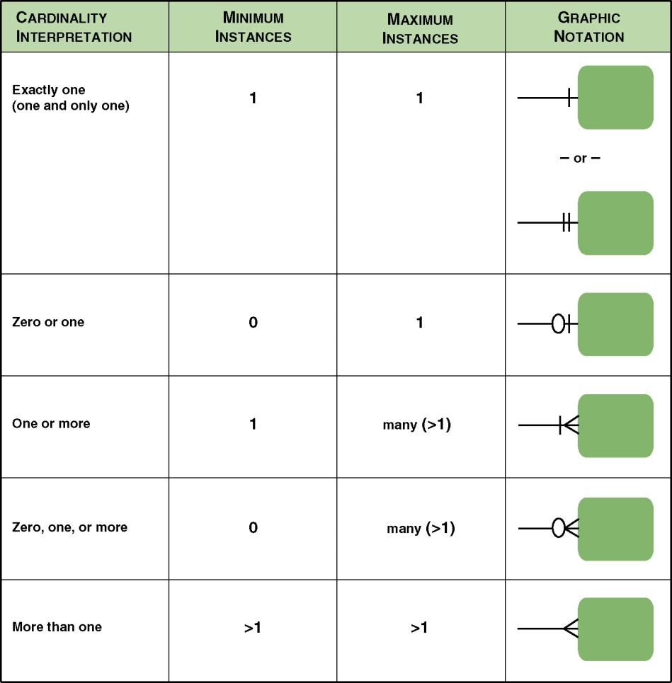

Slide 69
What about our DT228/DT282 data?

